Slide 1
Greek Alphabet and Pronunciation
Prof. Vanessa Gorman
University of Nebraska-Lincoln
vgorman1@unl.edu

Slide 2
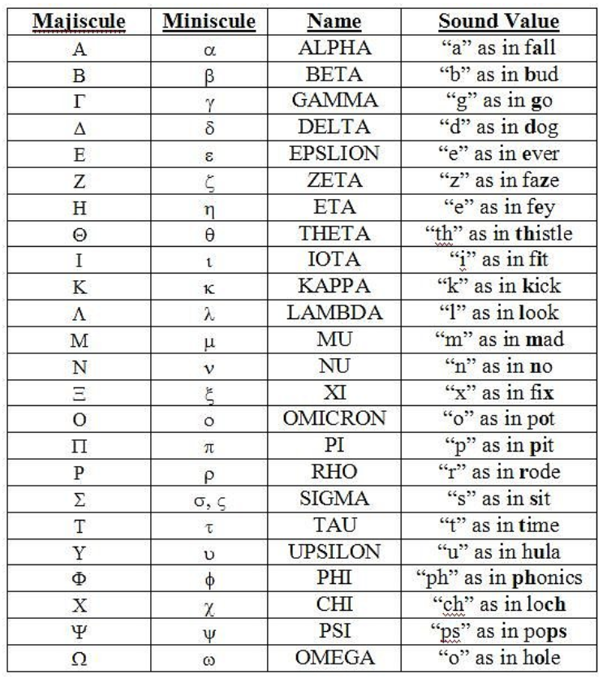
Image courtesy of: free-online-bible-study.org/greek-alphabet.html

Slide 3
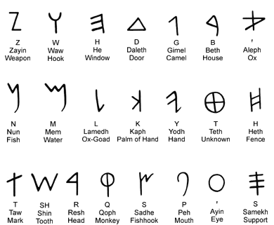
Phoenician Alphabet

Slide 4
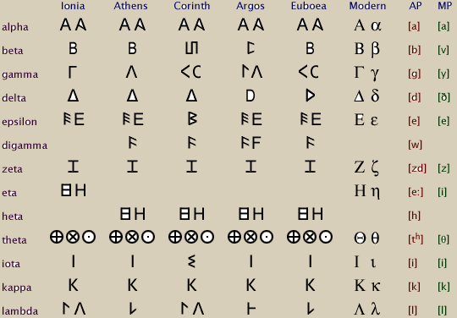

Slide 5
Image courtesy of: free-online-bible-study.org/greek-alphabet.html

Slide 6
Image courtesy of: free-online-bible-study.org/greek-alphabet.html
Double consonants
d+s = zeta
k+s = xi
p+s = psi

Slide 7
Image courtesy of: free-online-bible-study.org/greek-alphabet.html
Aspirants
t + h = theta
p + h = phi
k + h = chi

Slide 8
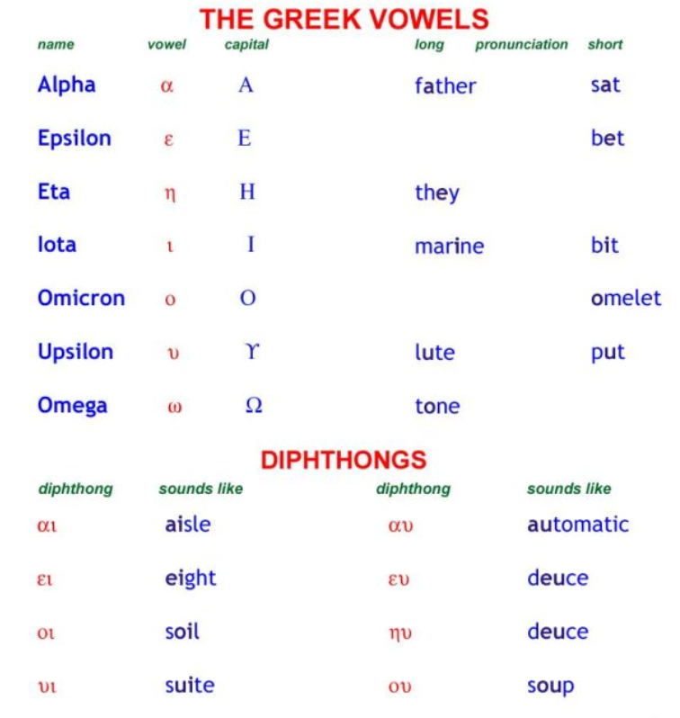
Image courtesy of: free-online-bible-study.org/greek-alphabet.html

Slide 9
Breathing marks
Every word beginning with a vowel or a rho must have a breathing mark
On the second letter of a diphthong
Smooth breathing = apostrophe
ἀνεβίβαζε, ἐγγὺς, Ἀθηναῖοι, αὐτὸν, οὐδὲν
Rough breathing = reverse apostrophe. Indicates aspiration [“h” sound]
ἑαυτοῦ, ὅπως, ῥᾴδιος, ῥήτωρ, εἷλον

Slide 10
Accents
Pitch vs stress accents
Accents, punctuation, and word division added in Hellenistic Era to help distinguish readers.
Accents only occur on vowels [second letter of a diphthong]
Diphthong has accent [and breathing] over the second vowel
Accents only on the final three syllables
Ultimate
Penultimate
Antepenultimate
Three accents
Acute ́ (examples: Λακεδαιμόνιοι, τέτταρσι)
Grave ̀ (examples: εὐθὺς, Δωριεὺς)
Circumflex ͂ (examples: χειμῶνος, ναῦς)

Slide 11
Acute Accent ( ́)
Can occur on any of the last three syllables.
πρότερα, ὥσπερ, παραγγελλόμενα
Can only be on the last syllable if it is the end of a sentence or clause, or an unaccented word follows it.
διὰ ταῦτα δὲ εὐεργεσία τε καὶ πολιτεία Συρακοσίοις ἐν Ἀντάνδρῳ ἐστί. [Xen., Hell. 1.1.26]
παρῄνεσάν τε προθύμους εἶναι καὶ τὰ λοιπά, ὥσπερ τὰ πρότερα. [Xen., Hell. 1.1.27]
Can only be on the antepenultimate, if the final syllable is short (by nature and position).
παρεκελεύετο, Φαρνάβαζος, Συρακόσιοι (!)

Slide 12
Grave Accent( ̀)
Can only occur on the last syllable.
Only if another word follows [you flip the acute to a grave]
διδοὺς καὶ ὕλην
καὶ τὴν δεκάτην ἐξέλεγον
Σηλυμβριανοὶ δὲ ἐδέξαντο μὲν οὔ , χρήματα δὲ ἔδοσαν .

Slide 13
Circumflex Accent ( ͂ )
Can only occur on the last two syllables
ἐπεισπλεῖ, ἐκ τῶν Κλαζομενῶν
μηδεὶς ἐξαγγείλαι τοῖς πολεμίοις τὸ πλῆθος τῶν νεῶν
Can only occur on a long vowel
παρὰ τῶν Κυζικηνῶν, ναυμαχεῖν [diphthong], ἡμῖν [rare long iota]
Can only occur on the penultimate if the final vowel is short
ἐκεῖθεν, Ἀθηναῖοι, ἐπαινοῦντες

Slide 14
Miscellaneous
Accents on nouns are persistent
Accents on verbs are recessive
Moveable nu [ἐκέλευε = ἐκέλευεν]
Elision (contraction):
Words ending with a short vowel followed by a word beginning with a vowel sometimes contract the final vowel, replacing it with an apostrophe
μηδ᾽ αὖ Φαρνάβαζος
οὐδ᾽ ἐγὼ ἀντιλέγω
Sometimes written as one word

Slide 15
Enclitic
“Leans back” = forms part of the preceding word
καὶ συγκαλέσας τούς τε ἀπὸ τῶν πόλεων στρατηγοὺς … [Xen., Hell. 1.1.25]
Usually loses its accent (unless followed by another enclitic)
εἴ πού τίς τινα ἴδοι ἐχθρόν… [Thuc. 4.47, “If ever anyone saw an enemy anywhere” = Smyth 185]
Therefore, sometimes adds another accent, because the existing accent is pushed beyond the antepenult.
παρῄνεσάν τε προθύμους εἶναι [Xen., Hell. 1.1.27]
χρήματά τε διδοὺς καὶ ὕλην ἐκ τῆς Ἴδης κομίζεσθαι φράζων. [Xen., Hell. 1.1.25]

Slide 16
Proclitic
Articles that begin with a vowel, some prepositions, the word “no”
Leans forward = forms part of the following word
μετὰ δὲ ταῦτα Τισσαφέρνης ἦλθεν εἰς Ἑλλήσποντον. [Xen., Hell. 1.1.9]
ἐκεῖθεν δὲ ἅπασα ἡ στρατιὰ διέβη εἰς Λάμψακον. [Xen., Hell. 1.2.14]
No accent, except (very rarely) at the end of a sentence or right before an enclitic.

Slide 17
Punctuation
Period and comma = normal
Semicolon = Greek ?
Raised dot = Greek semi-colon
Iota subscript = ᾳ, ῃ, ῳ
αἱ νῆες ἅπασαι ἐν Παρίῳ ἀνηγάγοντο [Xen., Hell. 1.1.13]
τῇ δὲ ὑστεραίᾳ Ἀλκιβιάδης ἐκκλησίαν ποιήσας … [Xen., Hell. 1.1.13]
Diaresis
naïve, [coöperate and reëlect]
νηΐ [“to a ship”] or προϊτέον [“one must advance”]

Slide 18
On-line pronunciation guides
Mastronarde’s AtticGreek.org page Pronunciation Guide
http://atticgreek.org/pronunc/pronunc_guide.html
Podium Arts Excellent Readings You Tube channel https://www.youtube.com/channel/UCv2q9OTZ0w4zCnt6NDjQZ-A
Homer, Od. 1.1-27 [with text and translation] https://www.youtube.com/watch?v=MOvVWiDsPWQ
Plato, Apology 1-3 [with Greek text] https://www.youtube.com/watch?v=YGITyNb4CUo
Aristotle, Politics 1.12 [with Greek text] https://www.youtube.com/watch?v=g1mOT1RH8o8
Accentuation tutorial: http://ucbclassics.dreamhosters.com/ancgreek/accenttutU/accentuationU.html

